Slide 1
Cyclistic Capstone Project
Gian Taparan, last updated April 17, 2024

Slide 2
Table of contents
1
2
3
Business Task
Identifying Cyclistic’s needs
Data Description
Where the data comes from and its credibility
Data Documentation
Cleaning and manipulation of the data

Slide 3
Analysis Summary
4
Key findings and trends in the data
5
Data Visualizations
Plots, charts, and other graphs
Recommendations
6
High-level content recommendations

Slide 4
Business Task
How can trends in bike usage identify points of interest for the marketing team that may guide any future strategies?
We have been tasked with analyzing differences in bike usage between annual Cyclistic members (subscribers) and casual riders (customers).
We can then use these insights to identify why casual riders might buy an annual membership as well as how we can influence them to do so.

Slide 5
Data Description
Cyclistic Trip Data
public data made available by Motivate International Inc. under this license
Cyclistic is a fictional company, so the datasets have a different name
contains bike usage information based on user type for each quarter-year from 2015 to 2020, as well as station data
some datasets contain monthly information
I am working with the two most recent quarters with data (2019 Q4 and 2020 Q1)

Slide 6
Data Documentation
Cleaning and manipulation of the data took place over the course of six days (3/20/24-3/25/24, 4/15/24).
The tools used were Google Sheets and Python.
Four files were uploaded to Google Sheets and a Python IDE. From there, columns were added, updated, and deleted to create clean tables for analysis.
For full documentation of formulas used and all changes made, see here.

Slide 7
Analysis Summary
Saturday and Sunday
These same days
The weekdays (M-F)
see, on median, the most bike share usage by customers.
typically see more total customer activity than subscriber activity.
on the other hand, see more total subscriber activity.
Customers bike for longer
About half of subscriber rides
About two-thirds of customer rides
median-wise than subscribers do, regardless of day, although less frequently.
are taken on routes that have seen over 30 rides (Q1 2020).
are taken on routes that have between 1 and 12 rides (Q1 2020).

Slide 8
Analysis Summary
My initial analysis revealed that the weekends (Saturday and Sunday) are more popular for bike usage for customers (users without a subscription). Sunday in particular is the most popular, with customers’ median ride length at 23:47 in Q4 2019 and 27:34 in Q1 2020. Additionally, these two days overwhelmingly see more total customer bike share usage than that of subscribers.
On the other hand, while the median ride length remains relatively equal for subscribers regardless of day, the total time of bike share usage is significantly higher during the weekdays (Monday through Friday) than the weekends compared to that for customers.
Despite this, customers still seem to ride their bikes for longer regardless of day, when looking at the median ride length.

Slide 9
Analysis Summary
After this initial analysis, I decided to look further into the bike rides themselves by studying the frequency of routes taken as well as the routes themselves, specifically for Q1 of 2020. For the purposes of this study, I defined a popular route as one taken at least once a day, for a third of the quarter (>=30 rides) and an unpopular route was one taken, on average, once a week or less (<=12 rides). A route is defined as a pair of station IDs: one as the start of the ride and the other as the end.
When looking at subscriber only rides, about half (44.5%) of them were taken on popular routes. Comparatively, when looking at customer only rides, just over two-thirds (67.7%) of them were taken on unpopular ones.
This, combined with an overwhelming subscriber popularity for weekday usage, implies that commuting using bikes may be a large reason for why people have purchased a subscription instead of remaining a customer. On the other hand, these customer trends imply usage of bikes typically for recreational purposes, and do not need the bike share service for daily use.

Slide 10
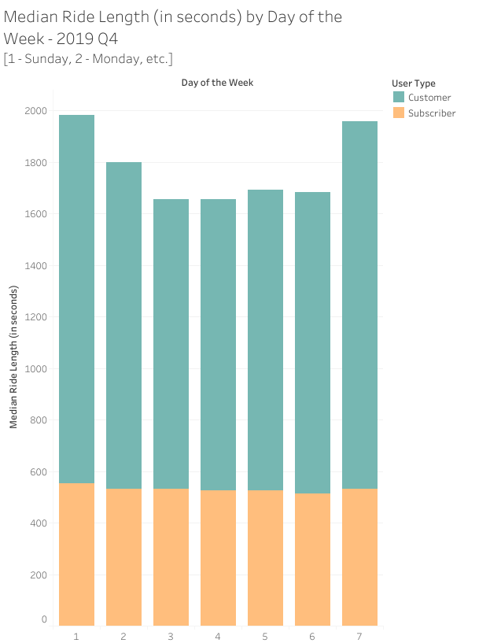
Data Visualizations
Median Ride Length (in seconds) by Day of the Week - 2019 Q4
Saturday (1426 sec) and Sunday (1427 sec) are the days with the highest median ride length for customers
subscriber median ride length only ranges from 513 sec (Friday) to 554 sec (Sunday)

Slide 11
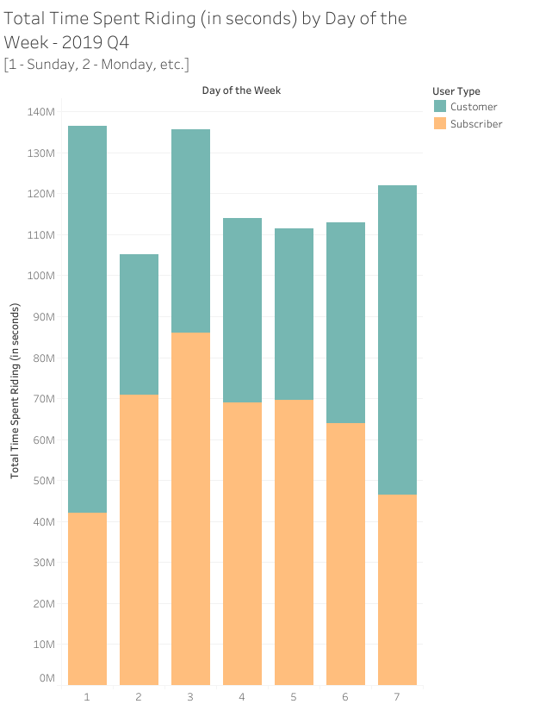
Total Time Spent Riding (in seconds) by Day of the Week - 2019 Q4
Saturday (~75 million) and Sunday (~94 million) see the most total customer bike usage
Monday (~85 million) and Tuesday (~70 million) see the most total subscriber bike usage

Slide 12
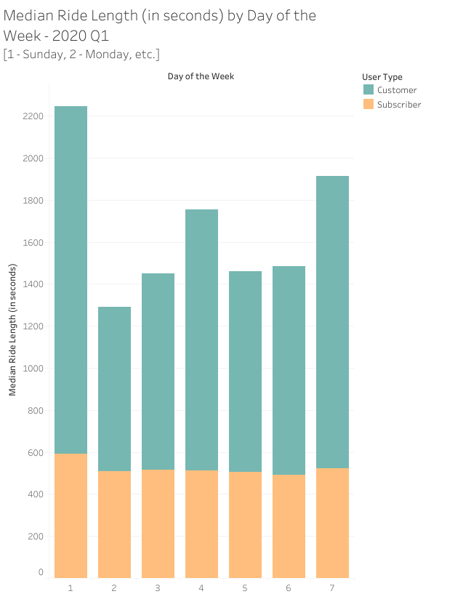
Median Ride Length (in seconds) by Day of the Week - 2020 Q1
just as in Q4 2019, Saturday (1392 sec) and Sunday (1654 sec) are the days with the highest median customer ride lengths
subscriber ride lengths only range from 493 sec (Friday) to 591 sec (Sunday)

Slide 13
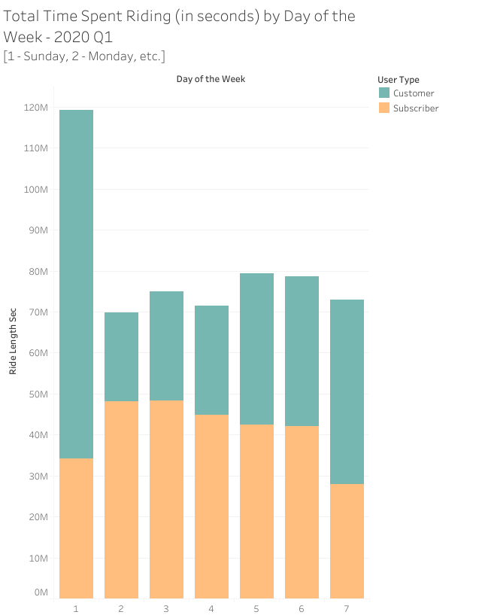
Total Time Spent Riding (in seconds) by Day of the Week - 2020 Q1
Saturday (~45 million) and Sunday (~85 million) see the most customer bike usage
Monday (~21 million) sees the least
Monday (~48 million) and Tuesday (~49 million) see the most subscriber bike usage

Slide 14
Recommendations
From my analysis, I found that the weekend is the most popular time for customers to ride bikes, and that recreation seems to be an important factor in customers using the service. Keeping these in mind, I would recommend that Cyclistic’s social media team organize recreational group rides with local health organizations or charities. Posts could be made to spread publicity for these events. Promotional subscription offers could also be made exclusively for those that attend group rides and create posts for social media showcasing their attendance.
Cyclistic’s marketing team could also promote subscription benefits at these group rides, highlighting features such as unlimited rides or even implement new features such as priority access to bikes or a bike reservation system at each station.
This type of community engagement could help boost Cyclistic’s local social media presence as well as encourage customers into becoming subscribers.

